Slide 1
AMS Training Package
Introduction of Banking Data Warehouse Application
Aug 2018

Slide 2
Agenda
Data Warehouse Instruction
1) Data Warehouse Project background
2) Data Warehouse Architecture
3) Data Warehouse application
  FS-LDM
  Single Customer View
Data Mart Instruction
1) Unica Data Mart
2) CRM Data Mart
The future of Data Warehouse
Page <number>

Slide 3
Part 1 Data Warehouse Instruction
Page <number>

Slide 4
Data Warehouse System Background
  Application Name: Group Data Warehouse(GDW)
  Banking data warehouse application
  Client Server and HOST architecture
Page <number>

Slide 5







Information Architecture
Systems
Data Integration
Data Warehouse
Analytics
Users
Systematics/Finacle
Business Intelligence
Extract
Detailed and Summary Data
Analyze
Reporting
Avaloq
Cleanse
Staging
Data Warehouse
Query
Standardize
Vision Plus
Transform
Analysis
Dashboards
IBR
CRM
Data Mart
Unica
Data Mart
Event/
Notification
Leaps
EPRC
Data Mart
Basel III
Data Mart
Predictive
Analytics
……
Business Glossary
Text files/manual file
Meta Data
Page <number>

Slide 6
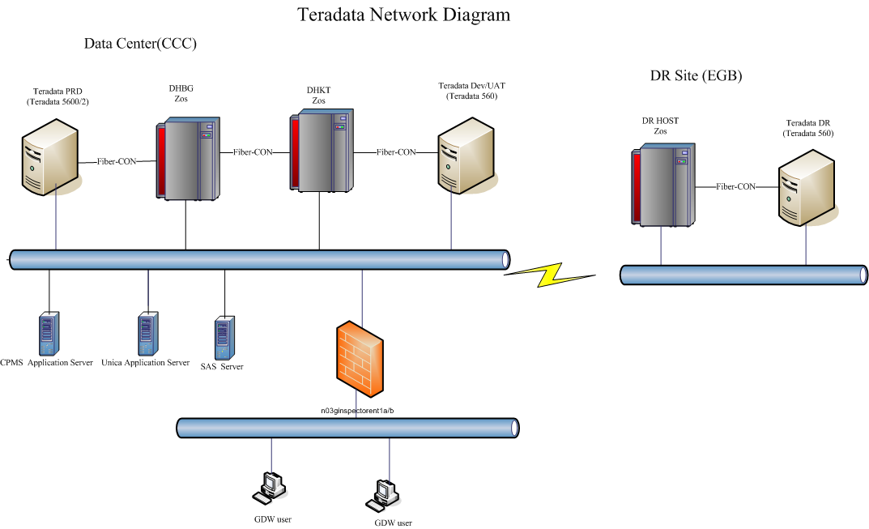
Page <number>

Slide 7
Data Warehouse Application
FC
LEAPS
CBDINV
FinIQ
BOSS
CD Staging
CBHKSS
MUREX
VGI
CPMS
TMS
MLI
TMS
AVQ
CBHKSS
ATMH
CONNOM
HKCOLS
BIP(AVQ)
B2SAS
CEP
BIP(CCP)
Gweb
GDW
GCG
BIP(FIN)
ITS
LAM/LRE/CCP
BIP(IPE)
User
BDW
BIP(IB)
BIP
BIP(KONY)
AVQ
GMI
BIP(SOI)
BNK
GUT
GAS
CCP
LRM/LRE/LAM/LCL/LTS
Vplus (UL)
GB2
TZ
GFU
GCI
RE3
IMEX
CDM
FPRO
Smart Workstation
……
Page <number>

Slide 8
ETL Time Schedule
03:30
17:00
18:00
23:55
6:00
12:00
23:00
00:00
Banking loading
GDW
Credit Card
Single view
Backup Tables
GAS
Unica& EPRC
CRM
Page <number>

Slide 9
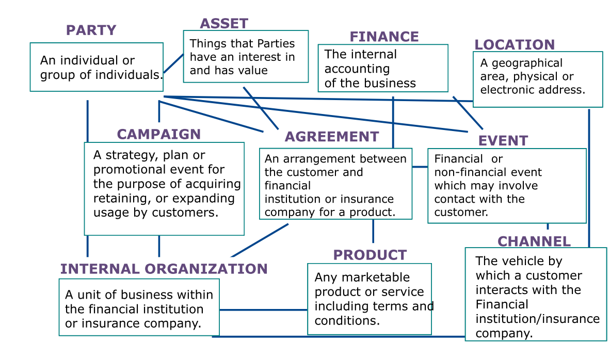

FS-LDM
Page <number>

Slide 10
Overview of ‘TL’
BIPW
BIPS
EUCT
E
L
L
T
Multi-Load
Post-Processing
Interface Files
Extraction
Transformation
Loading
Source
System
Page <number>

Slide 11
High level job flow diagram
DHBG-BATCH-START
Generate single view
DHBG-READY
Generate interface for other
GDW batch begin
systems
Run Prepare Job
Housekeeping
Copy interface from other
Backup interface and
systems
DB
Load data into GDW
GDW batch end
Page <number>

Slide 12
Interface File Type (Basic)
Full Set (e.g. Account Master)
  All records, even there is no change
  Simple extraction by source system
Daily Delta (e.g. Transactions)
  Only records changed for the day
  Need to log changes in source system
  Potential miss in capturing of change

Slide 13
Interface File Type (Adv.)
Cycle Delta (e.g. Credit Card Accounts)
  Daily Delta, PLUS
  Full Set if falls on cycle date
  Automatic synchronization
Extended Delta
  Daily Delta for last consecutive days, say 7 days
  Automatic recovery from daily failure

Slide 14
Input File Validation
Header/Trailer Record
  Header date against processing date
  Record count against processed detail records
To detect
  Input files not updated
  File integrity error due to file transfer failure

Slide 15
TL: Update MCIF
Empty MCIF.xx
Copy from LOAD.xx to MCIF.xx
Collect statistics on MCIF.xx
Update job status to RUN_CONTROL

Slide 16
Load - Replace
Complete replacement
Logic
  Empty LOAD
  Multi-load into LOAD
  Replace MCIF from LOAD
    Empty MCIF
    Copy LOAD to MCIF

Slide 17
Load - Append (Small)
Applicable for small tables
Logic
  Copy MCIF to LOAD
  Multi-load into LOAD (Insert)
  Replace MCIF from LOAD

Slide 18
Load - Append (Large)
Applicable for large tables
Logic
  Empty LOAD
  Multi-load into LOAD
  Append to MCIF from LOAD

Slide 19
Load - Upsert
Equals Update + Insert
Logic
  Copy MCIF to LOAD
  Multi-load into LOAD
    If record found by key, Update
    If record not found by key, Insert
  Replace MCIF from LOAD

Slide 20
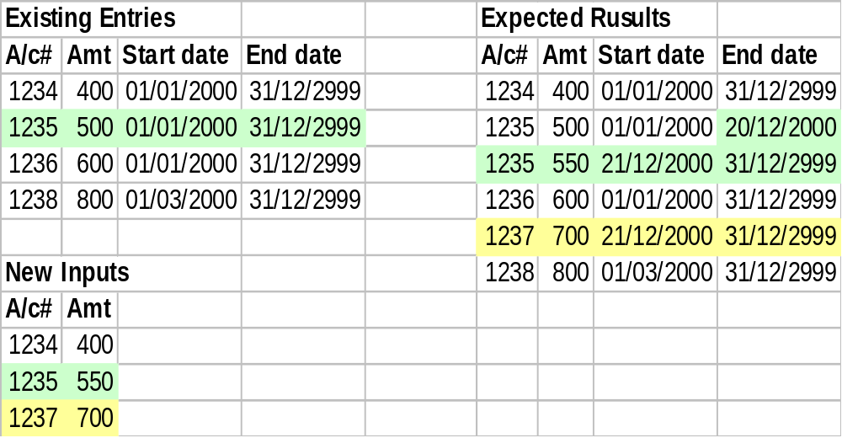
Load - Compact Upsert #1
For keeping value histories by date range

Slide 21
Single Customer View
Provides a unified view of integrated client data distributed across multiple computing resources
It can be used to power campaign management, direct marketing, data analysis, customer insight and business decision-making.
Page <number>

Slide 22
Gen. SCV tables
Party
Party_Acct
Party_phone
Party_addr
Party_Party_relation
Acct
Acct_addr
Acct_Acct_relation
Page <number>

Slide 23
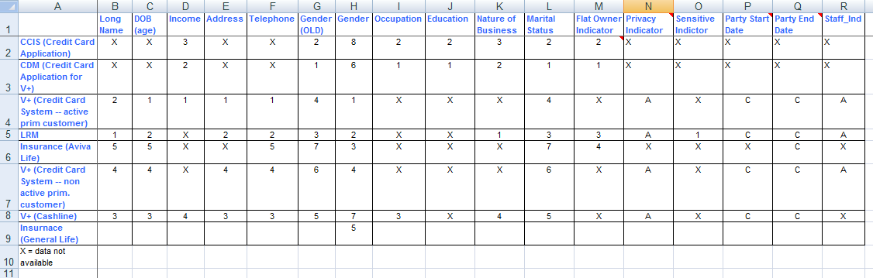
Party
Selection logic:
Page <number>

Slide 24
Party_addr
Selection logic:
PRIORITY SYSTEM
-------- -------------------------------
1 V+ (CREDIT CARD SYSTEM -- WITH ACTIVE PRIM. CARD)
2 RM BANK PARTY (DHB)
3 CASHLINE (CSHLINE_PARTY)
4 V+ (CREDIT CARD SYSTEM -- WITHOUT ACTIVE PRIM. CARD)
- CCIS (CREDIT CARD APPLICATION)
Document_Nbr | Document_Id_Type_Code | Country_Of_Issue | Addr_Use_Code | Addr_Line_1 | Addr_Line_2 | Addr_Line_3 | Addr_Line_4
CSVUC10070 | 2 |  | M | LEVEL 13 | MILLENNUM CITY 6 | 352 KWUN TONG ROAD | KWUN TONG KOWLOON
Z6675027 | B | CN | M | ROOM H 27/F | BLOCK 1 | LOK HIN TERRACE | CHAI WAN HK

Slide 25
Party_phone
Selection logic:
PRIORITY SYSTEM
-------- -------------------------------
1 V+ (CREDIT CARD SYSTEM - ACTIVE PRIM CARD)
2 RM BANK PARTY
3 CASHLINE
4 V+ (CREDIT CARD SYSTEM - NON ACTIVE PRIM CARD)
- CCIS (CREDIT CARD APPLICATION)
5 AVIVA LIFE
6 MANULIFE MLI
7 AVIVA GI
Document_Nbr | Document_Id_Type_Code | Country_Of_Issue | Phone_Type_Code | Phone_Nbr | Phone_Ext | Phone_accepted_ind
P3094263 | 1 |  | R | 23924532 | ? | N
A9438311 | 1 |  | M | 93562992 | ? | N

Slide 26
Gen. SCV report to downstream system
1. Generate party information report
2. Generate active party account information report
3. Generate active account balance amount report
  including loan, deposit, unit trust, credit card, securities and insurance
Page <number>

Slide 27
Part 2 Data Mart Instruction
  Unica Data Mart
  CRM Data Mart
Page <number>

Slide 28
Unica Data Mart
Unica data mart Instruction
  Unica Campaign
    Campaign Management
    Vendor Management
Page <number>

Slide 29
Logical Diagram for GAS(Unica)
C:D Staging Server(W)
Hong Kong Mainframe (H)
GAS(Unica)
SSH
C:D
UNICA
(1)
CLI
HK Teradata DB Server
Unica
Data Mart
GDW DB
ODBC
Page <number>

Slide 30
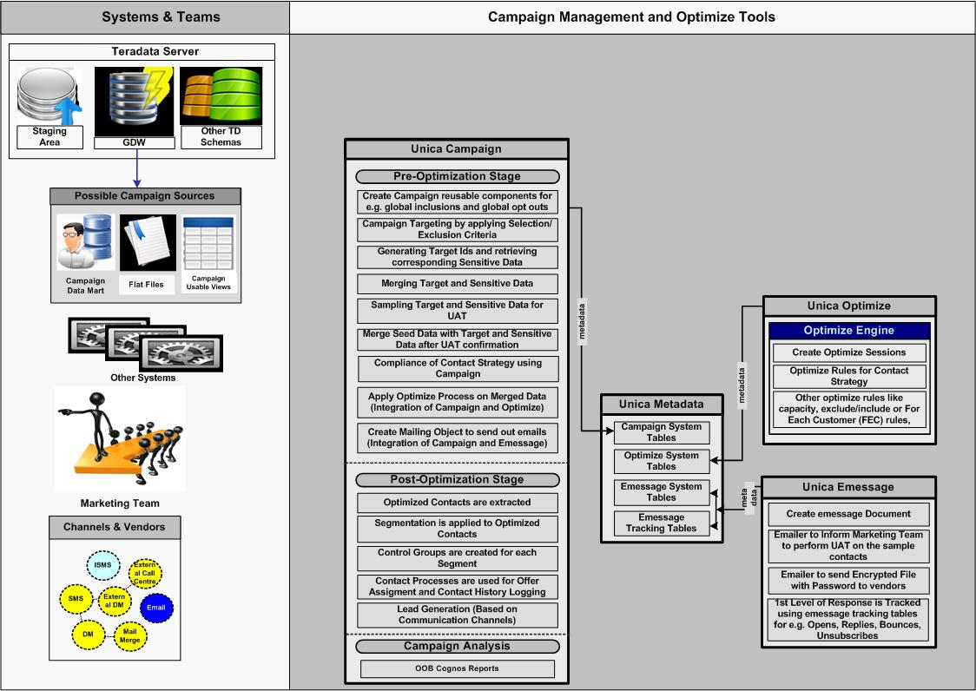
Unica Campaign Instruction
Page <number>

Slide 31
CRM Data Mart
CRM Data Mart Instruction
  Microsoft Dynamics Customer Relationship Management (CRM)
    Customer Management
    Service Management
    Marketing Management
    Product Management
Page <number>

Slide 32
Logical Diagram for GAS(CRM)
Hong Kong Mainframe (H)
GAS(CRM)
C:D
CRM
C:D
CLI
HK Teradata DB Server
CRM
Data Mart
GDW DB
Page <number>

Slide 33
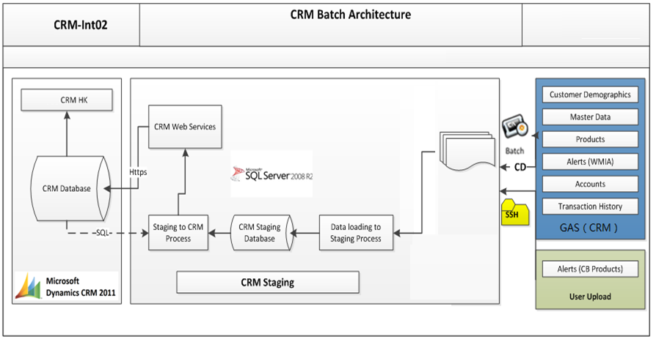
CRM Batch Architecture
Page <number>

Slide 34
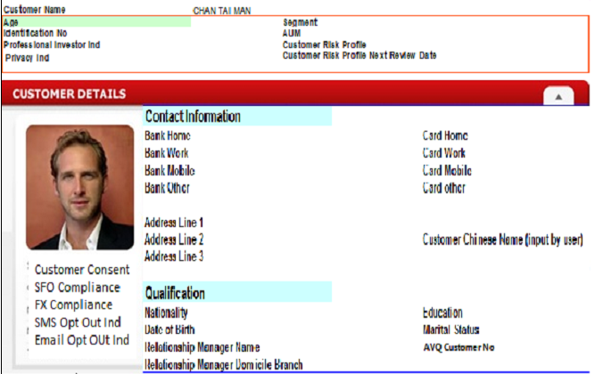
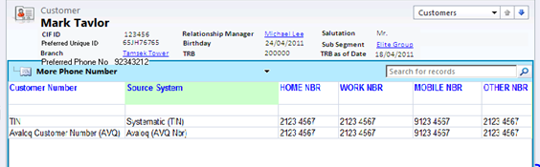
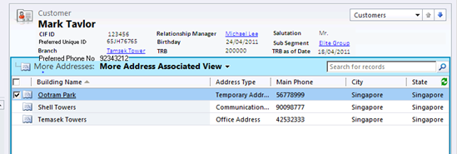
Customer Demographics
Customer Overview
    General Information
    Contact Information
    Qualification
More phone
More address
Page <number>

Slide 35
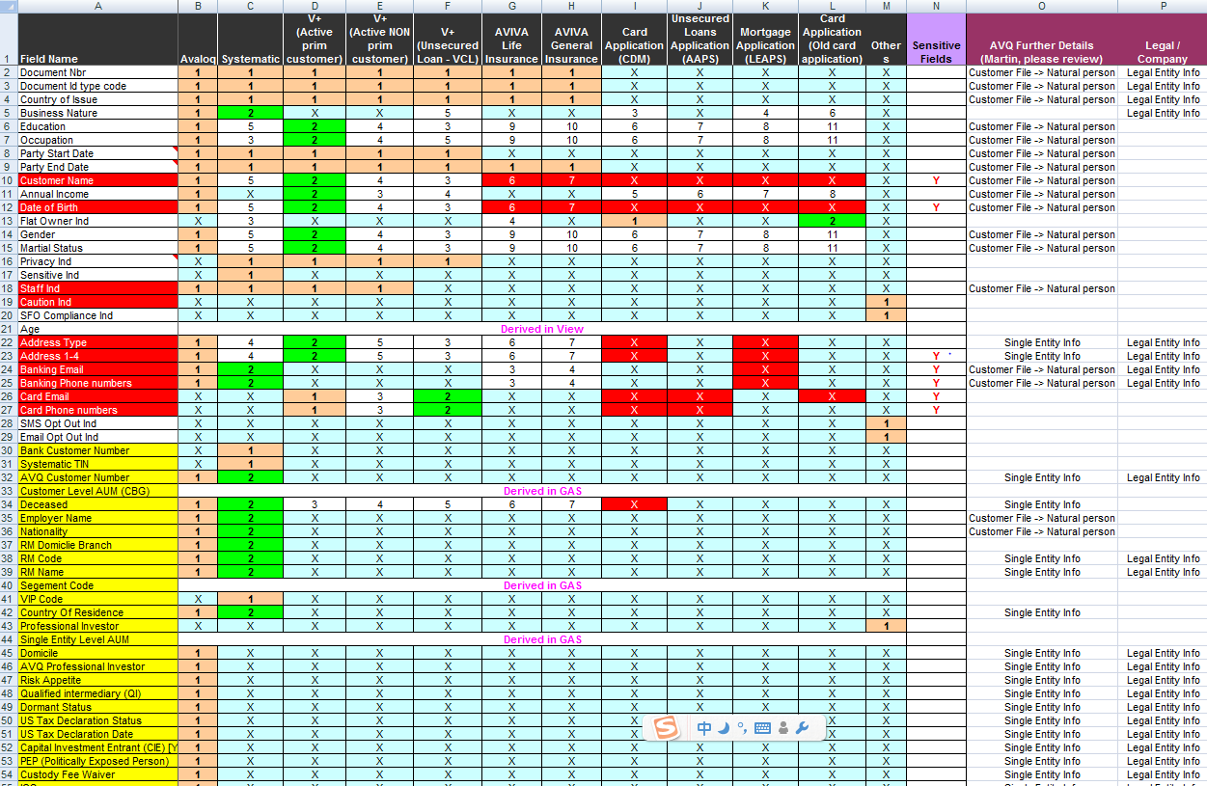
Customer information selection
Page <number>

Slide 36
Product and account
Cash
Total Investment Portfolio
Secured Loans
Unsecured Loans
Other Cash Investment
Credit Card
Total Insurance Portfolio
Trade Finance
Segment
Self-Service Channels
Page <number>

Slide 37
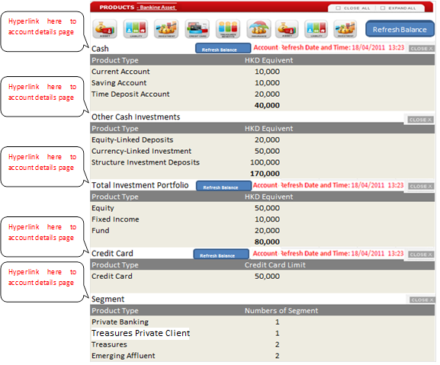
Account Details
Page <number>

Slide 38
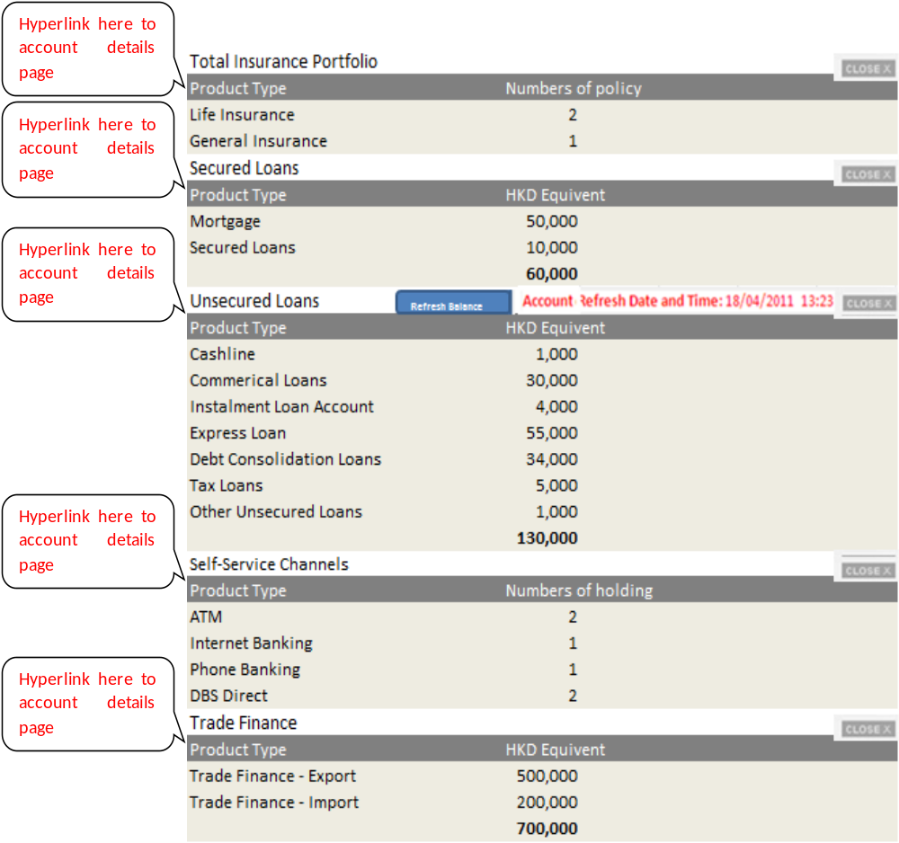
Page <number>

Slide 39
Master Data
There are 30 reference tables.
1 Address Type
2 Phone Type
3 Country
4 Branch
6 Officer Name
7 Document Type
8 Marital Status
……
Page <number>

Slide 40
Alerts
Alerts List
  Birthday Reminder Alert
  Deceased Alert
  Staff Alert
  Return mail status Alert
  TD/SP Maturity
  Expire PI(professional Investment) Status Alert
Page <number>

Slide 41
Part 3 Data warehouse of the future
Page <number>

Slide 42
Customer center
Analysis of unstructured data
Risk prediction
Page <number>

Slide 43
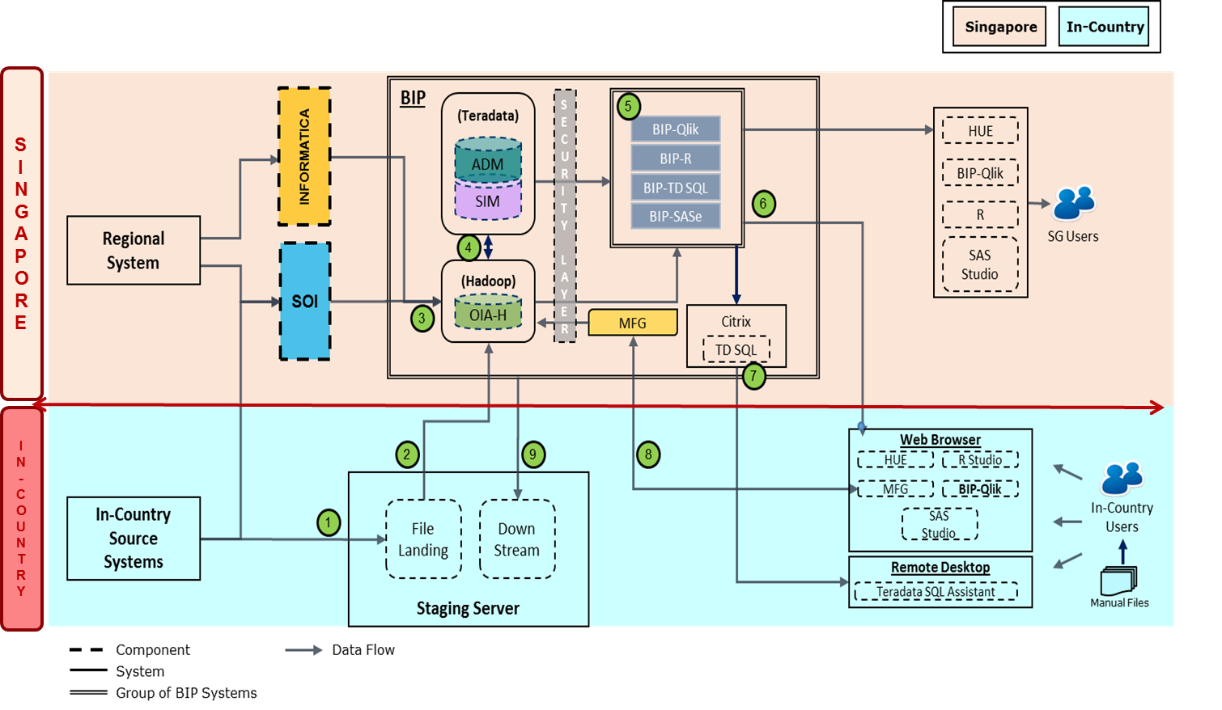
Page <number>

Slide 44
Thank You
Page <number>

